Slide 1
HOMEWORK 10 Due 6/11 00:00 send to e3

Slide 2
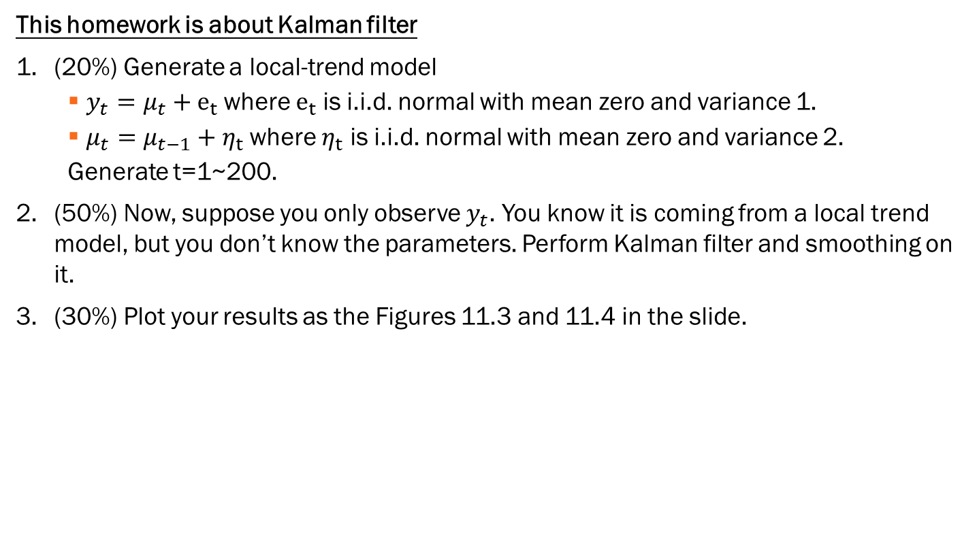
This homework is about Kalman filter
(20%) Generate a local-trend model
$y_{t}=μ_{t}+e_{t}$ where $e_{t}$ is i.i.d. normal with mean zero and variance 1.
$μ_{t}=μ_{t−1}+η_{t}$ where $η_{t}$ is i.i.d. normal with mean zero and variance 2.
Generate t=1~200.
(50%) Now, suppose you only observe $y_{t}$. You know it is coming from a local trend model, but you don’t know the parameters. Perform Kalman filter and smoothing on it.
(30%) Plot your results as the Figures 11.3 and 11.4 in the slide.

